Slide 1



EcoTraffic
Spatiotemporal Entropy & Eco-Dynamics Estimation Using Computer Vision
By- Nasim Raj Laskar

Slide 2

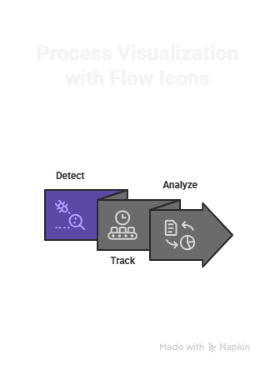
Learning Objectives
Understand traffic as a non-equilibrium system influenced by velocity fluctuations
Apply information theory (Shannon entropy) to quantify motion disorder
Use Kalman Filter tracking + velocity reconstruction for dynamic modeling
Develop eco-dynamic estimations from motion:
1. Efficiency
2. CO₂ emission trend proxy
Implement a fully video-based pipeline requiring no additional sensors
Perform statistical testing (ANOVA, Mann–Whitney, correlations) on traffic behavior
GOAL

Slide 3
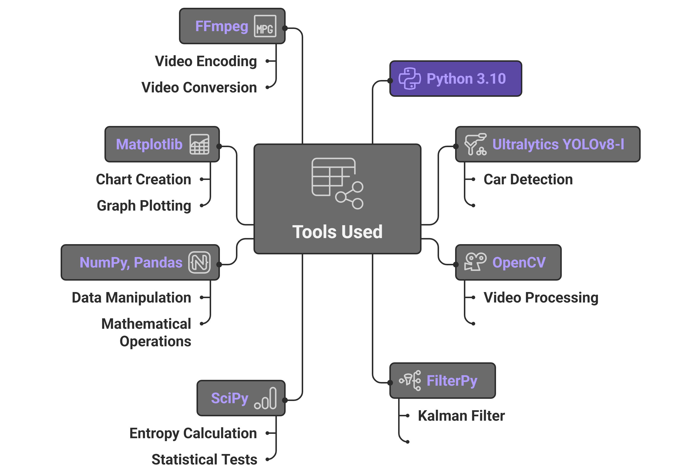



Tools and Technology used

Slide 4
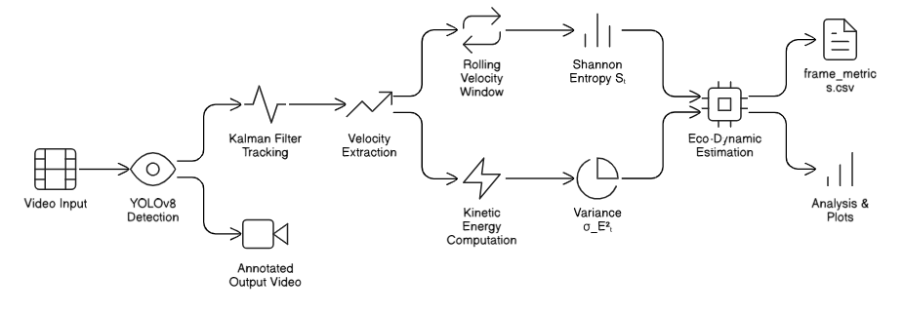
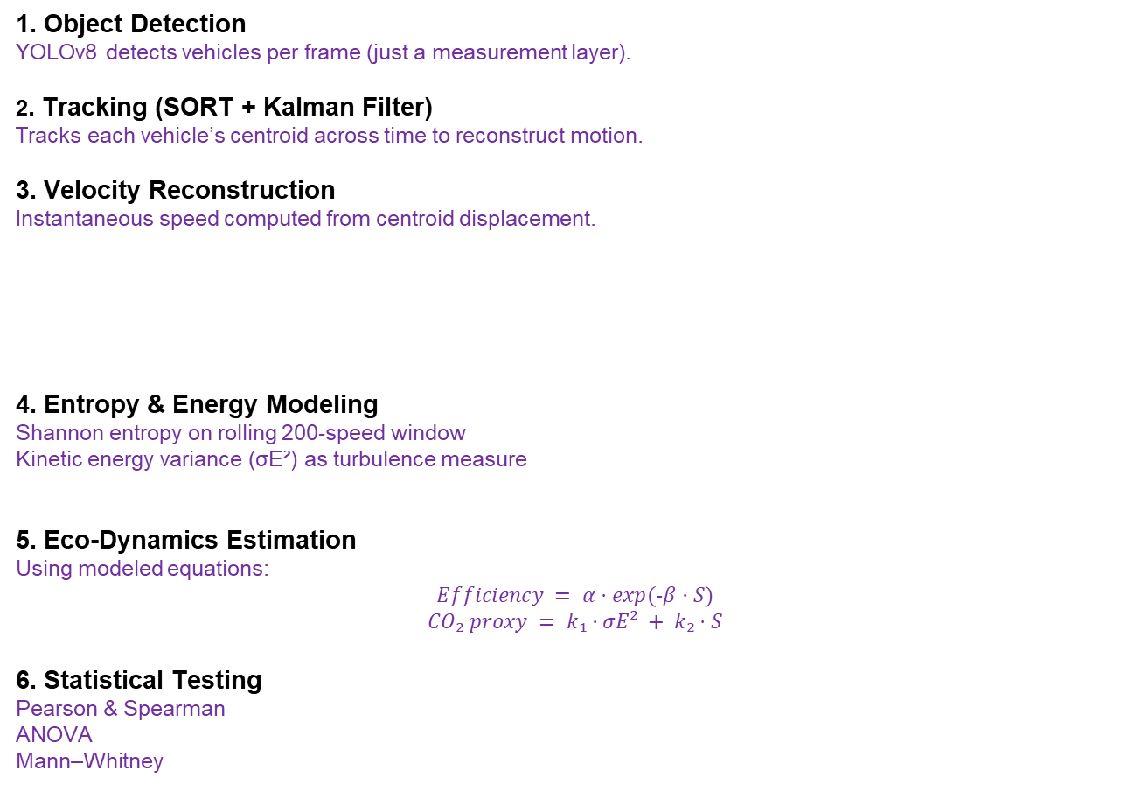
Methodology
1. Object Detection
YOLOv8 detects vehicles per frame (just a measurement layer).
2. Tracking (SORT + Kalman Filter)
Tracks each vehicle’s centroid across time to reconstruct motion.
3. Velocity Reconstruction
Instantaneous speed computed from centroid displacement.
4. Entropy & Energy Modeling
Shannon entropy on rolling 200-speed window
Kinetic energy variance (σE²) as turbulence measure
5. Eco-Dynamics Estimation
Using modeled equations:
$$Efficiency = α·exp(-β·S)$$
$$CO₂ proxy = k₁·σE² + k₂·S$$
6. Statistical Testing
Pearson & Spearman
ANOVA
Mann–Whitney
Workflow Of EcoTraffic

Slide 5



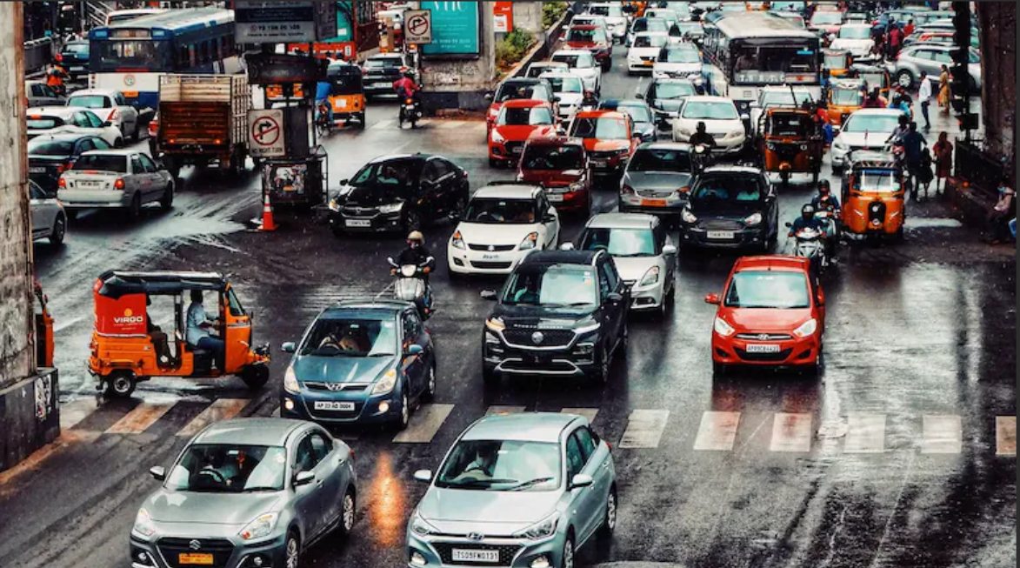
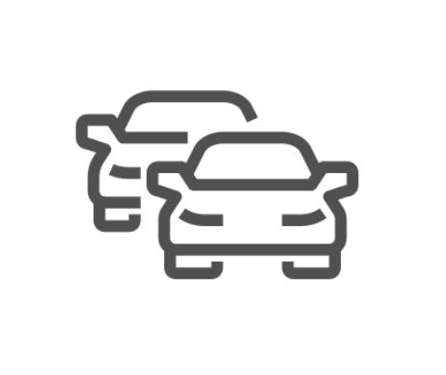



Problem Statement:
The Challenge
Traditional roadside traffic video analysis focuses on:
Counting vehicles
Classifying objects
Detecting lanes or anomalies
But these approaches do not quantify:
Traffic disorder
Motion stability
Energy dispersion
Environmental impact trends
There is no simple, purely video-based system that converts movement into eco-meaningful metrics.

Slide 6
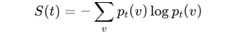
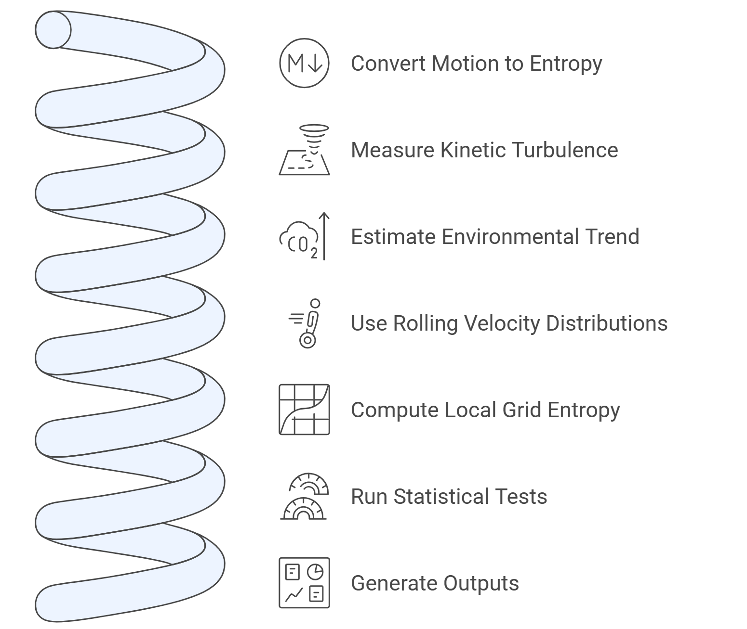
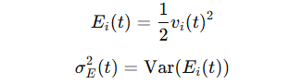
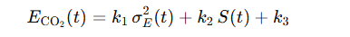
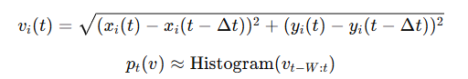
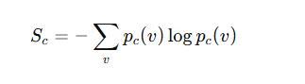
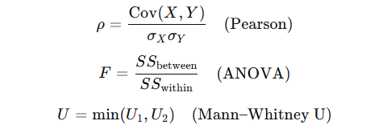
Solution: (Same Formulas are used in the Code)
1. Converts motion into global entropy signals S(t) using Shannon Entropy
2. Measures kinetic turbulence (motion variance) (σE²)
3. Estimates environmental trend via CO₂ proxy
4. Uses rolling velocity distributions for dynamics
5. Computes local spatiotemporal grid entropy (hotspots)
6. Runs statistical tests for segment-level differences
7. Generates annotated videos, CSV logs & time-series plots

Slide 7
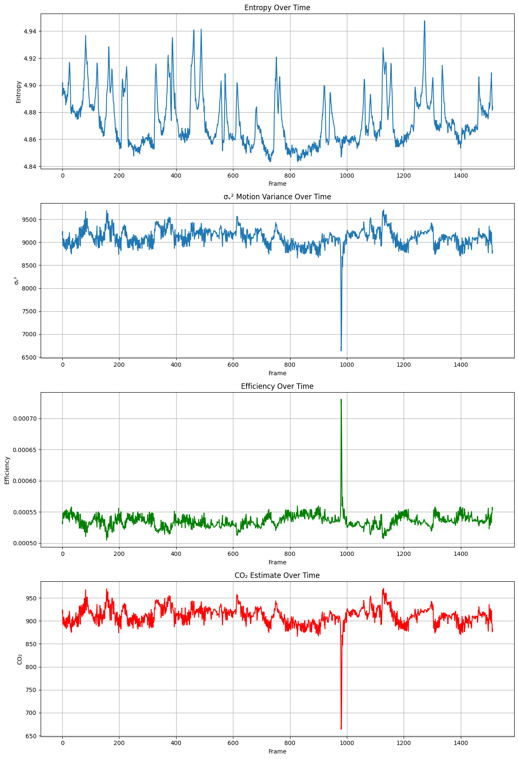
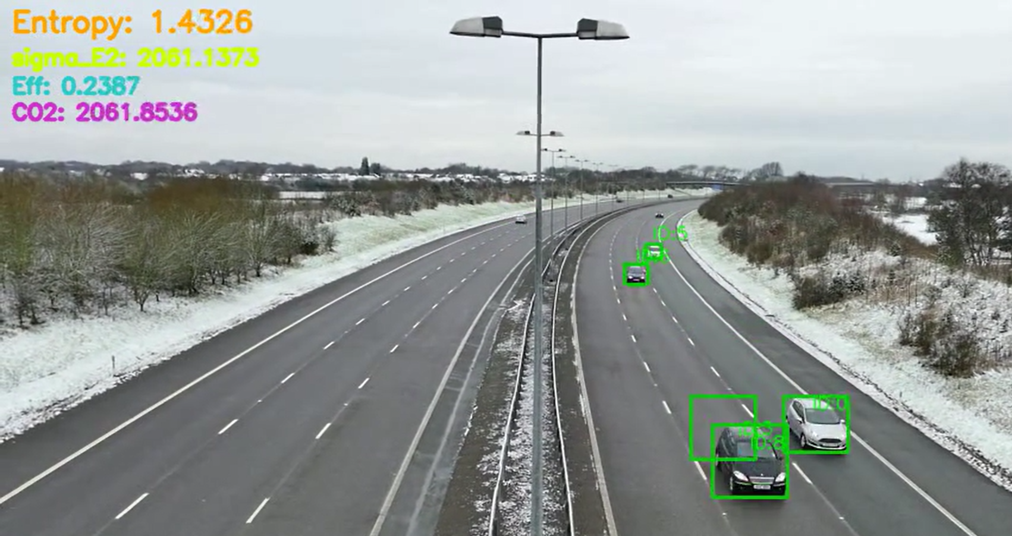
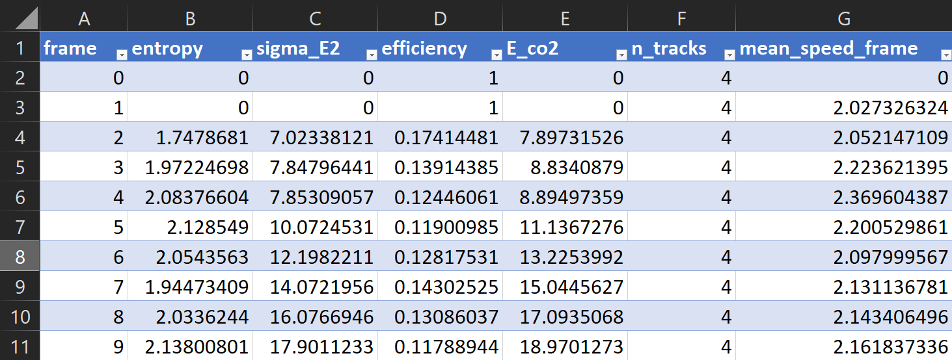
Time Series Plot of Entropy,Co2,sigma_E2,Efficiency over each frames(Time)
Screenshot of Output:
Annotated Video Frame with Bounding boxes , Vehicle IDs and “Entropy”, “σE²”, “Efficiency”, “CO₂” printed on frame
Sample(first 12 rows) of frame_metrics.csv that logs the data from the processed video

Slide 8
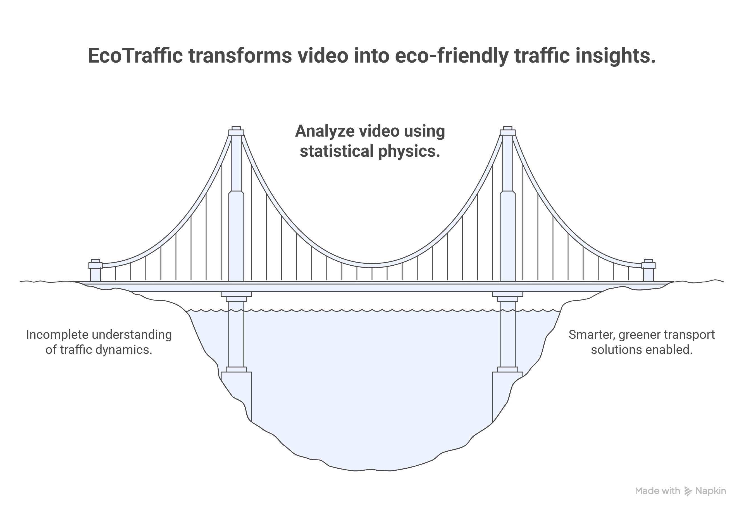
Conclusion:
EcoTraffic successfully demonstrates that:
Environmental and dynamical traffic insights can be extracted purely from video
Entropy and kinetic variance act as strong indicators of motion disorder
CO₂ trend proxy correlates with turbulence + entropy
The system is sensor-free, lightweight, and competition-ready
It bridges automotive analytics, computer vision, and environmental modeling
Final Impact:
EcoTraffic shows a novel direction for traffic research where video → statistical physics → eco-dynamics,
enabling smarter, greener transport analytics.

